Slide 1
The Java Agenda Manager

Slide 2

Traditional Agenda

Slide 3
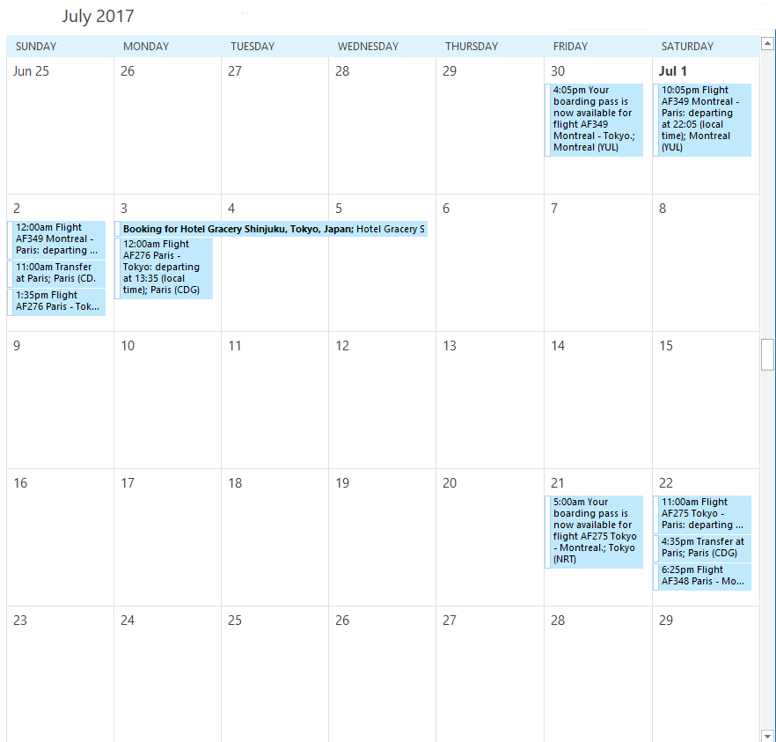
Outlook Monthly

Slide 4
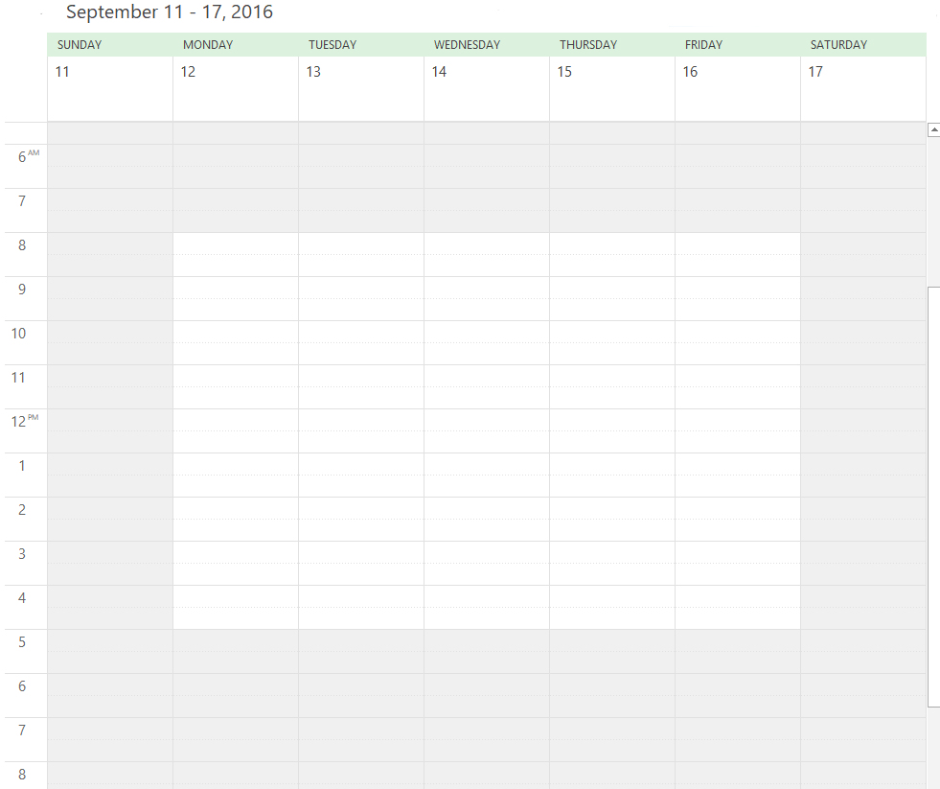
Outlook Weekly

Slide 5
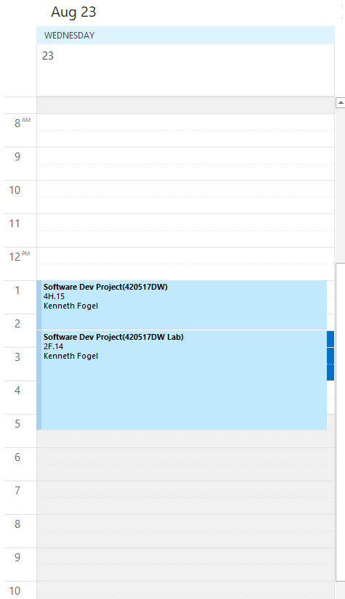
Outlook Daily

Slide 6



The Technologies We Will Use
Java 1.8
JavaFX 2.2
MySQL 5.7

Slide 7




The Technologies We Will Use
JDBC
JUnit 4
JavaMail / JODD

Slide 8



The Technologies We Will Use
Maven
Git
GitLab

Slide 9
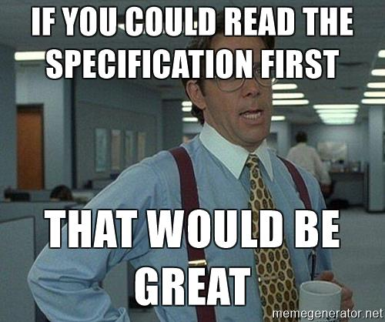
Step 1: Read The Specification

Slide 10
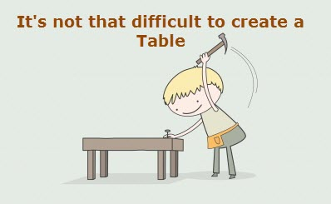
Step 2: Create the Database and Tables

Slide 11

Step 3: Write the Java JDBC CRUD code while at the same time . . .

Slide 12
Step 3: . . . Write Unit Tests After Every Method Is Coded

Slide 13


Week One Lab
Write the SQL scripts to create the necessary tables in MySQL and then email the scripts to
kfogel@dawsoncollege.qc.ca
by the end of the lab period.

